Slide 1
Parallel programming
In CUDA programming language

Slide 2
AGENDA
Introduction​ to parallel programming
What is block, grid, thread
​Application in microbiology
Linear Search using CUDA
​Binary Search using CUDA
Conclusion

Slide 3
Parallel programming
Parallel programming, in simple terms, is the process of decomposing a problem into smaller tasks that can be executed at the same time using multiple computing resources. In High-Performance Computing (HPC) systems, a node is a self-contained computer unit containing memory and processors running an operating system. Processors, such as central processing units (CPUs) and graphics processing units (GPUs), are chips containing cores. Cores are the units executing commands; there can be multiple cores in a processor and multiple processors in a node. With parallel programming, a developer writes code with specialized software to make it easy for them to run their program across multiple nodes or processors. For instance, if any program is run using a CPU has much more time complexity than a program using GPU i.e. the time complexity is drastically reduced using parallel programming.

Slide 4
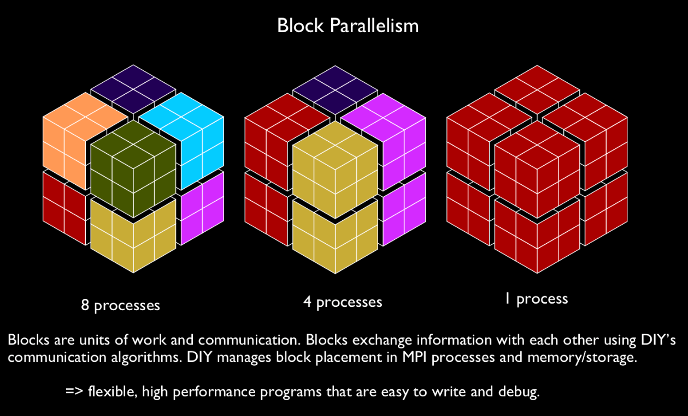
What is the block?
What is a block?

Slide 5
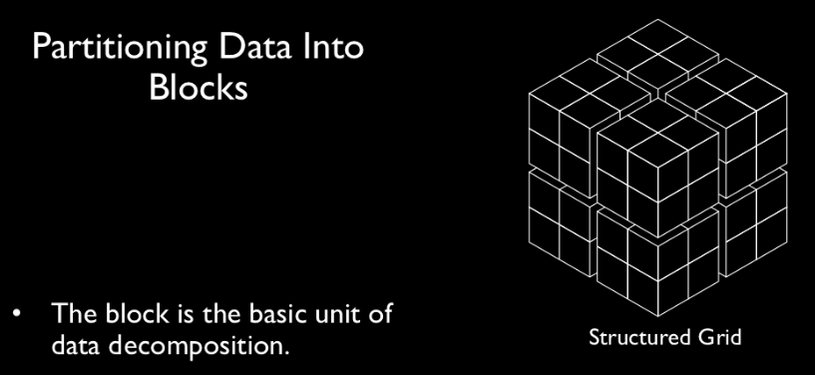
What are thread and grids?
Blocks can be further divided into grids and grids into threads.
Pictorial representation of grid:

Slide 6
Application in microbiology :
One of the applications of parallel programming
SOAP2: an improved ultrafast tool for short read alignment
Technology Used:
In the paper, they have developed an improved version of SOAP, called SOAP2. The new program uses the Burrows-Wheeler Transformation (BWT) compressed index instead of the seed algorithm that was used in the previous version for indexing the reference sequence in the main memory. The use of BWT substantially improved alignment speed and significantly reduced memory usage.

Slide 7
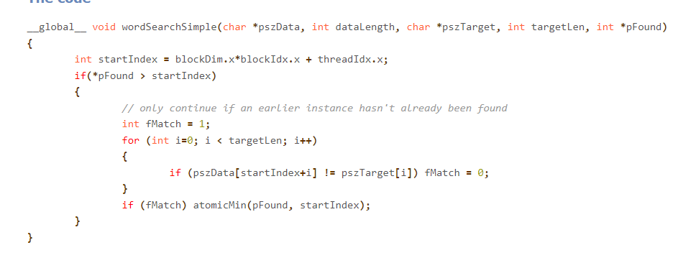
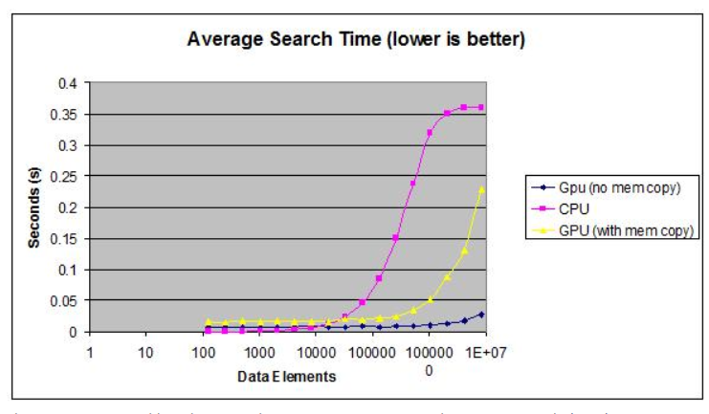
Linear search in CUDA :

Slide 8
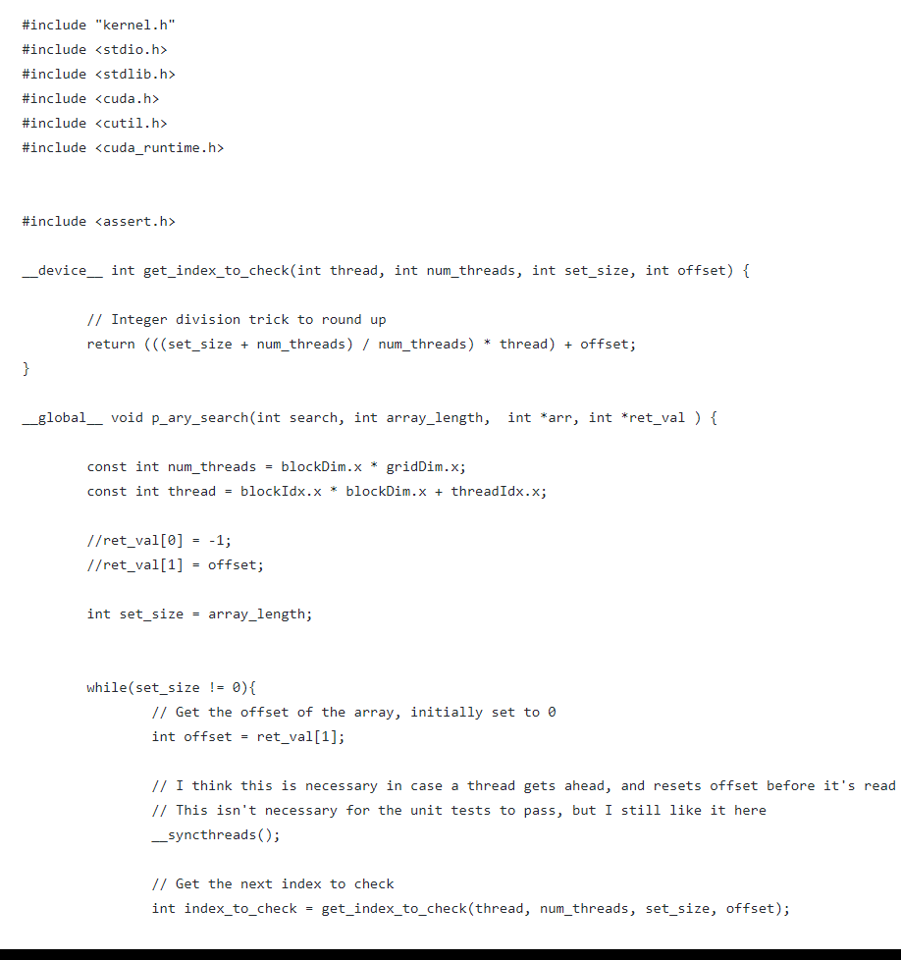
BINARY SEARCH IN CUDA:

Slide 9
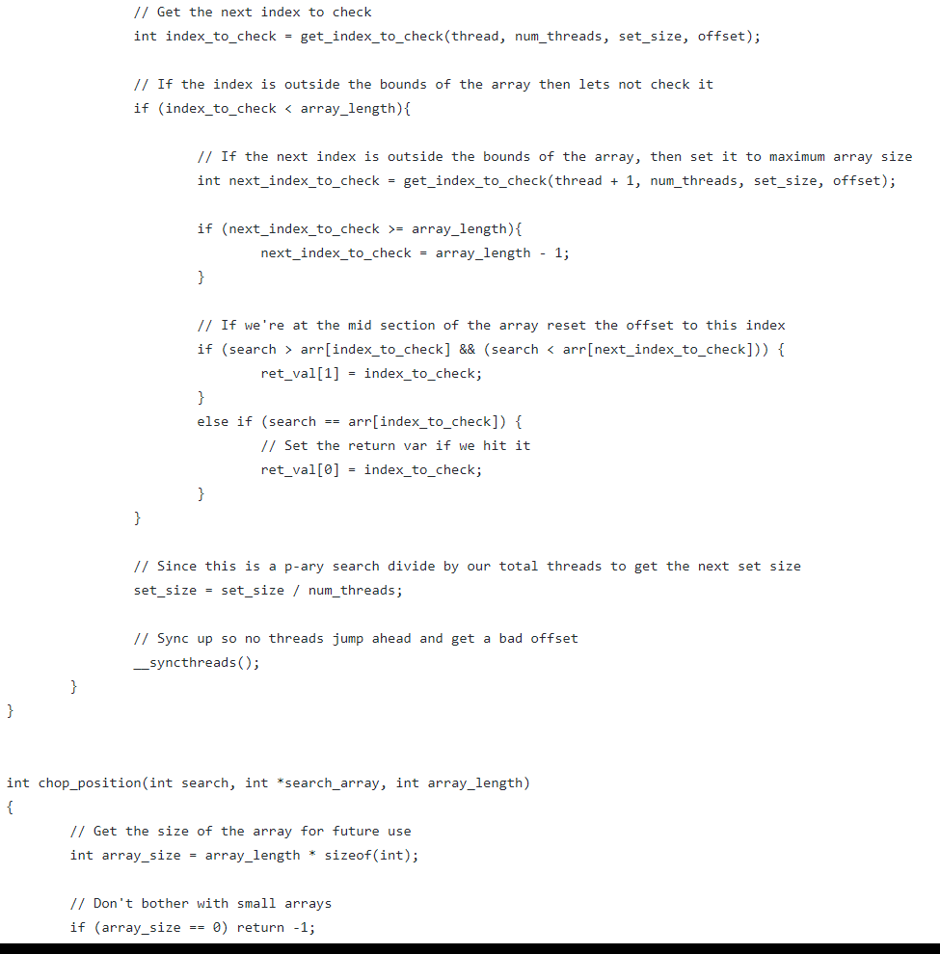

Slide 10
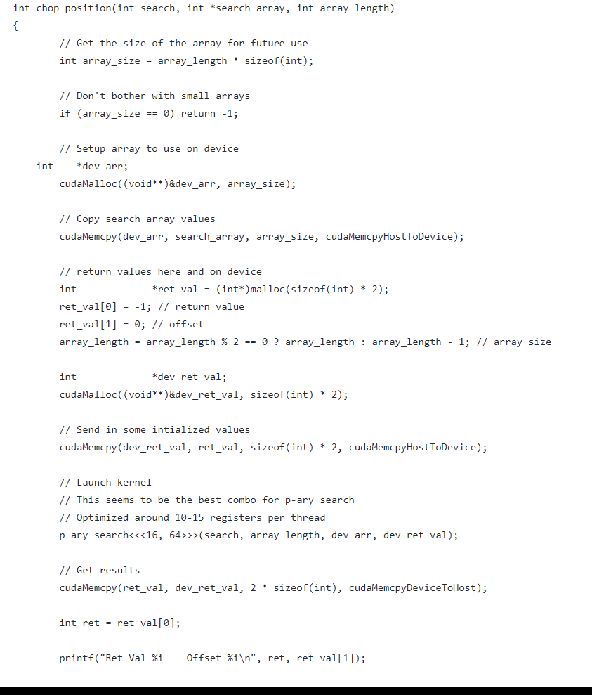

Slide 11
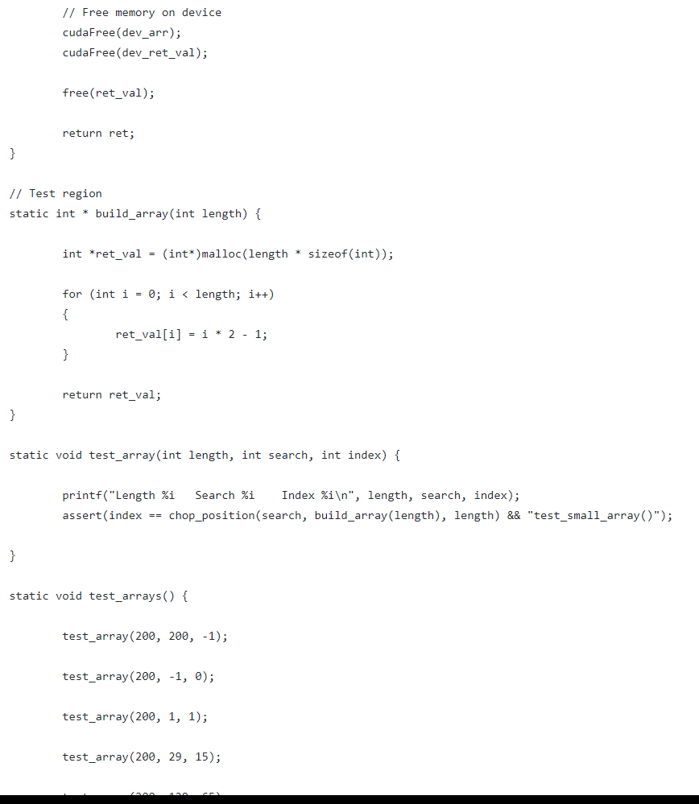

Slide 12
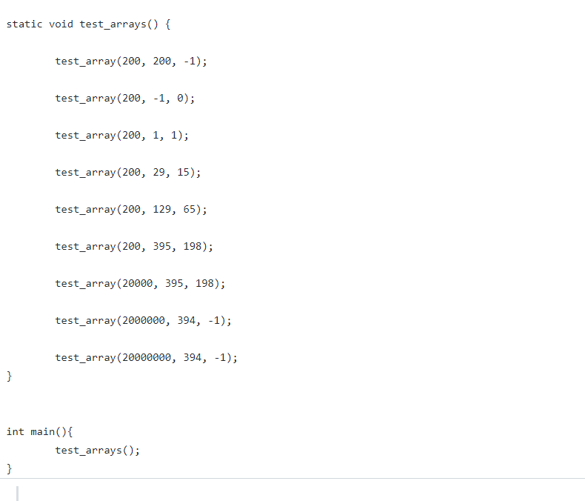

Slide 13
SUMMARY
The conclusion is that the time complexity is drastically reduced by using parallel programming.

Slide 14
THANK YOU

